Slide 1


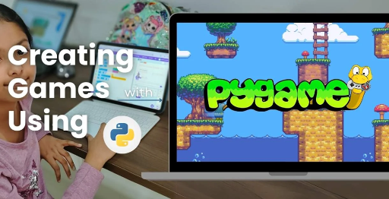
Session 10
Scoring & Game Over Logic

Slide 2
Learning Objectives
Understand game inspiration, install Pygame-CE, navigate project structure
Detailed Objectives:
Objectives:
Track player scores based on hits and destructions.
Implement win conditions (200 points for Quick Game, full destruction for Basic Game).
Display live scores and trigger the game over screen.

Slide 3
Practical Tasks
Understand game inspiration, install Pygame-CE, navigate project structure
Below is the list of Practical Tasks:
Add score tracking in game_modes.py (e.g., +10 points per block hit, +50 per alien).
Implement win condition checks for both modes.
Update game_screens.py to show live scores during gameplay and final results on the game over screen.
Test by playing a short game to trigger the game over screen.

Slide 4
Deliverables
Understand game inspiration, install Pygame-CE, navigate project structure
Session Deliverables:
game_modes.py with score tracking and win conditions.
A game over screen displaying the winner and final scores.
Tips:
Keep score displays simple and easy to read.
Celebrate when you trigger the game over screen—it means it works!

Slide 5
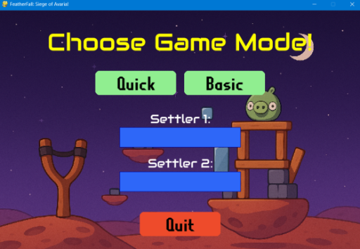
Scoring System & Game Over Logic in PyGame
🏁 Scoring System & Game Over Logic in PyGame
👉 Learn how to calculate scores, track win conditions, and trigger the Game Over screen in OMOGAME

Slide 6
OMOGAME - “Track, Score, Win!”
🏁 “Track, Score, Win!”
“Build a scoring system that responds to real gameplay actions” 👉 Introduce how scoring and game-over logic create structure and victory in games.
Introduce scoring and game-over logic in OMOTEC-PyGame: Siege of Avaria!
Inspired by Angry Birds, players destroy fortresses for points.
Learn to track scores and determine victory using Pygame-CE.
Focus: Create structure and excitement in two-player battles.
Covers both Quick and Basic Game modes.

Slide 7
What is a Game State?
🏁 What is a Game State?
Keeps track of what's happening during a game
Includes:
Current score
Whose turn it is
Whether someone has won 📌 Critical for both Quick and Basic Game modes
Tracks ongoing game dynamics and status.
Includes:
Current score for each player.
Current player’s turn.
Win or loss conditions.
Managed in game_modes.py for both modes.
Ensures fair gameplay and clear outcomes.
Critical for responsive and structured gaming.

Slide 8
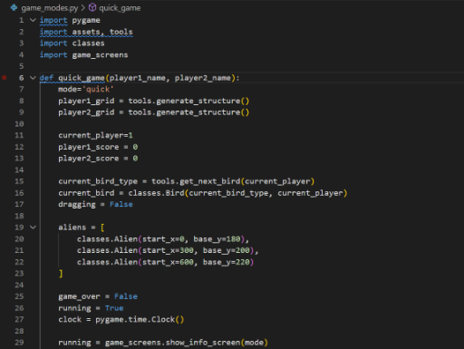
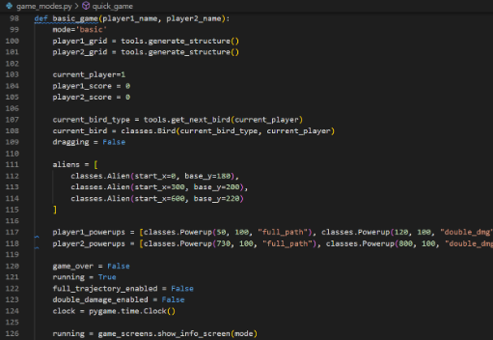
What is a Game State?
CODE SNIPPETs : GAME MODES

Slide 9
How Does Scoring Work in OMOGAME?
🏁 How Does Scoring Work in OMOGAME?
🏆 Quick Game: First to reach 200 points wins
💣 Basic Game: Destroy all structures
Each hit adds points to a player’s score
Aliens = bonus score
Quick Game: First to 200 points wins via hits on blocks/aliens.
Basic Game: Win by destroying all opponent structures.
Points awarded per hit on blocks or aliens.
Aliens provide bonus score for extra challenge.
Scoring logic in game_modes.py drives competition.
Varies by mode for diverse gameplay experiences.

Slide 10
Score Tracking in Code
🏁 Score Tracking in Code
In game_modes.py, update player scores like:
player1_score += hit_value
🧪 Use print() to debug scoring logic
🧠 Tip: Use dictionaries for cleaner tracking:
scores = {1: 0, 2: 0}
In game_modes.py:
scores = {1: 0, 2: 0}
scores[1] += hit_value
Use dictionaries for clean score tracking.
Update scores after collisions in tools.py.
Debug with: print("Player 1 Score:", scores[1]).
Supports both Quick and Basic mode scoring.
Ensures accurate and fair point allocation.

Slide 11
Checking for Game Over
🏁 Checking for Game Over
🛑 Create a function:
def check_game_over():
if player1_score >= 200:
return "Player 1 Wins!"
elif all_blocks_destroyed():
return "Player 2 Wins!"
💡 Called after each bird completes action
In game_modes.py:
def check_game_over():
if scores[1] >= 200:
return "Player 1 Wins!"
elif all_blocks_destroyed():
return "Player 2 Wins!"
Called after each bird’s action completes.
Checks Quick Mode (points) or Basic Mode (destruction).
Triggers game-over screen via game_screens.py.
Ensures clear win/loss determination.

Slide 12
Displaying the Game Over Screen
🏁 Displaying the Game Over Screen
Use game_screens.py to trigger end message:
show_game_over(winner)
🎉 Add restart and quit buttons 🖼 Display final scores and victory badge
In game_screens.py:
def show_game_over(winner):
screen.blit(winner_text, (x, y))
Displays winner message and final scores.
Adds restart and quit buttons for user control.
Uses assets.py for victory badge images.
Enhances player experience with clear feedback.
Renders via media/ resources for visuals.

Slide 13
Updating the UI to Show Scores
🏁 Updating the UI to Show Scores
In main.py or game_modes.py:
font = pygame.font.Font(None, 36)
text = font.render(f"Score: {scores[1]}", True, (255, 255, 255))
screen.blit(text, (50, 20))
📌 Live feedback makes gameplay feel rewarding
In main.py or game_modes.py:
font = pygame.font.Font(None, 36)
text = font.render(f"Score: {scores[1]}", True, (255, 255, 255))
screen.blit(text, (50, 20))
Displays live scores for both players.
Uses assets.py for font loading from media/.
Provides rewarding feedback during gameplay.
Updates each frame for real-time tracking.

Slide 14
Testing Game Over Scenarios
🏁 Testing Game Over Scenarios
✅ Test Cases:
Hitting multiple blocks to reach 200 points
Destroying all blocks in Basic Mode
Confirm score resets after restarting game
🛠️ Use logs: print("Checking Game Over...")
Test Cases:
Hit multiple blocks to reach 200 points in Quick Mode.
Destroy all blocks in Basic Mode.
Verify score resets after game restart.
Log checks: print("Checking Game Over...").
Test in game_modes.py for accuracy.
Ensure game_screens.py displays correct winner.

Slide 15
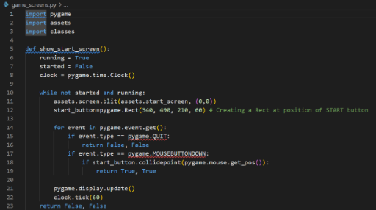
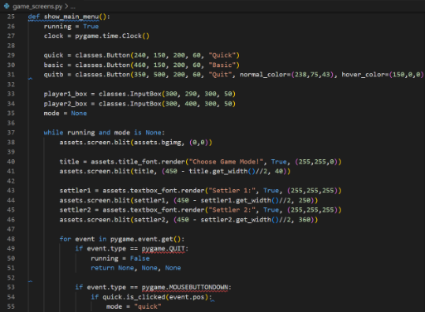
Testing Game Over Scenarios
CODE SNIPPETs : GAME SCREENS

Slide 16
Student Task – Build Your Own Victory Rule
🏁 Student Task – Build Your Own Victory Rule
🎯 Challenge:
Add a custom win condition
E.g., Alien defeated = instant win
Add victory message: “Alien Slayer!”
📂 Deliverables:
Updated game_modes.py
Screenshot of Game Over screen
Challenge:
Add custom win condition (e.g., “Alien defeated = instant win”).
Implement in game_modes.py.
Show victory message: “Alien Slayer!” on game-over screen.
Deliverables: Updated game_modes.py, screenshot of game-over screen.
Save as: my_victory_rule.py.
Submit for feedback on logic and creativity.

Slide 17
Recap – Scoring = Structure
🏁 Recap – Scoring = Structure
✔ You now understand:
Score tracking per player
Detecting and triggering Game Over
Displaying win results on screen
💬 Tip: Always test edge cases like tie scores or last-minute wins!
Achievements:
Tracked scores per player in game_modes.py.
Detected game-over conditions for both modes.
Displayed win results via game_screens.py.
Enhanced UI with live score updates.
Debugging tip: Test edge cases like ties or last-second wins.
Reference: Pygame CE Documentation (https://pyga.me/docs/).

Slide 18

Exercise:
1. What is the primary objective of the Quick Mode in OMOGAME?
A) Collect all power-ups before the opponent
B) Launch birds without any destruction
C) Reach a score of 200 points
D) Complete the entire storyline
Answer: C) Reach a score of 200 points
2. Which file is considered the main entry point of the OMOGAME project? A) tools.py
B) main.py
C) assets.py
D) classes.py
Answer: B) main.py

Slide 19
Exercise..
3. What does the tools.py file mainly handle in the game?
A) Launching sound and animation
B) Player avatar selection
C) Collision detection and drawing functions
D) Managing game instructions
Answer: C) Collision detection and drawing functions
4. Which of the following is NOT listed as a unique feature of OMOGAME? A) Bird classes with special physics
B) Alien targets for bonus points
C) Multiplayer online matchmaking
D) Destructible block environments
Answer: C) Multiplayer online matchmaking

Slide 20
Exercise…
5. Why is organizing the OMOGAME project into files like classes.py, media/, and game_modes.py important?
A) It reduces the game’s memory usage
B) It helps reduce the number of bugs completely
C) It makes the project look colorful
D) It simplifies managing and updating different game parts
Answer: D) It simplifies managing and updating different game parts

Slide 21
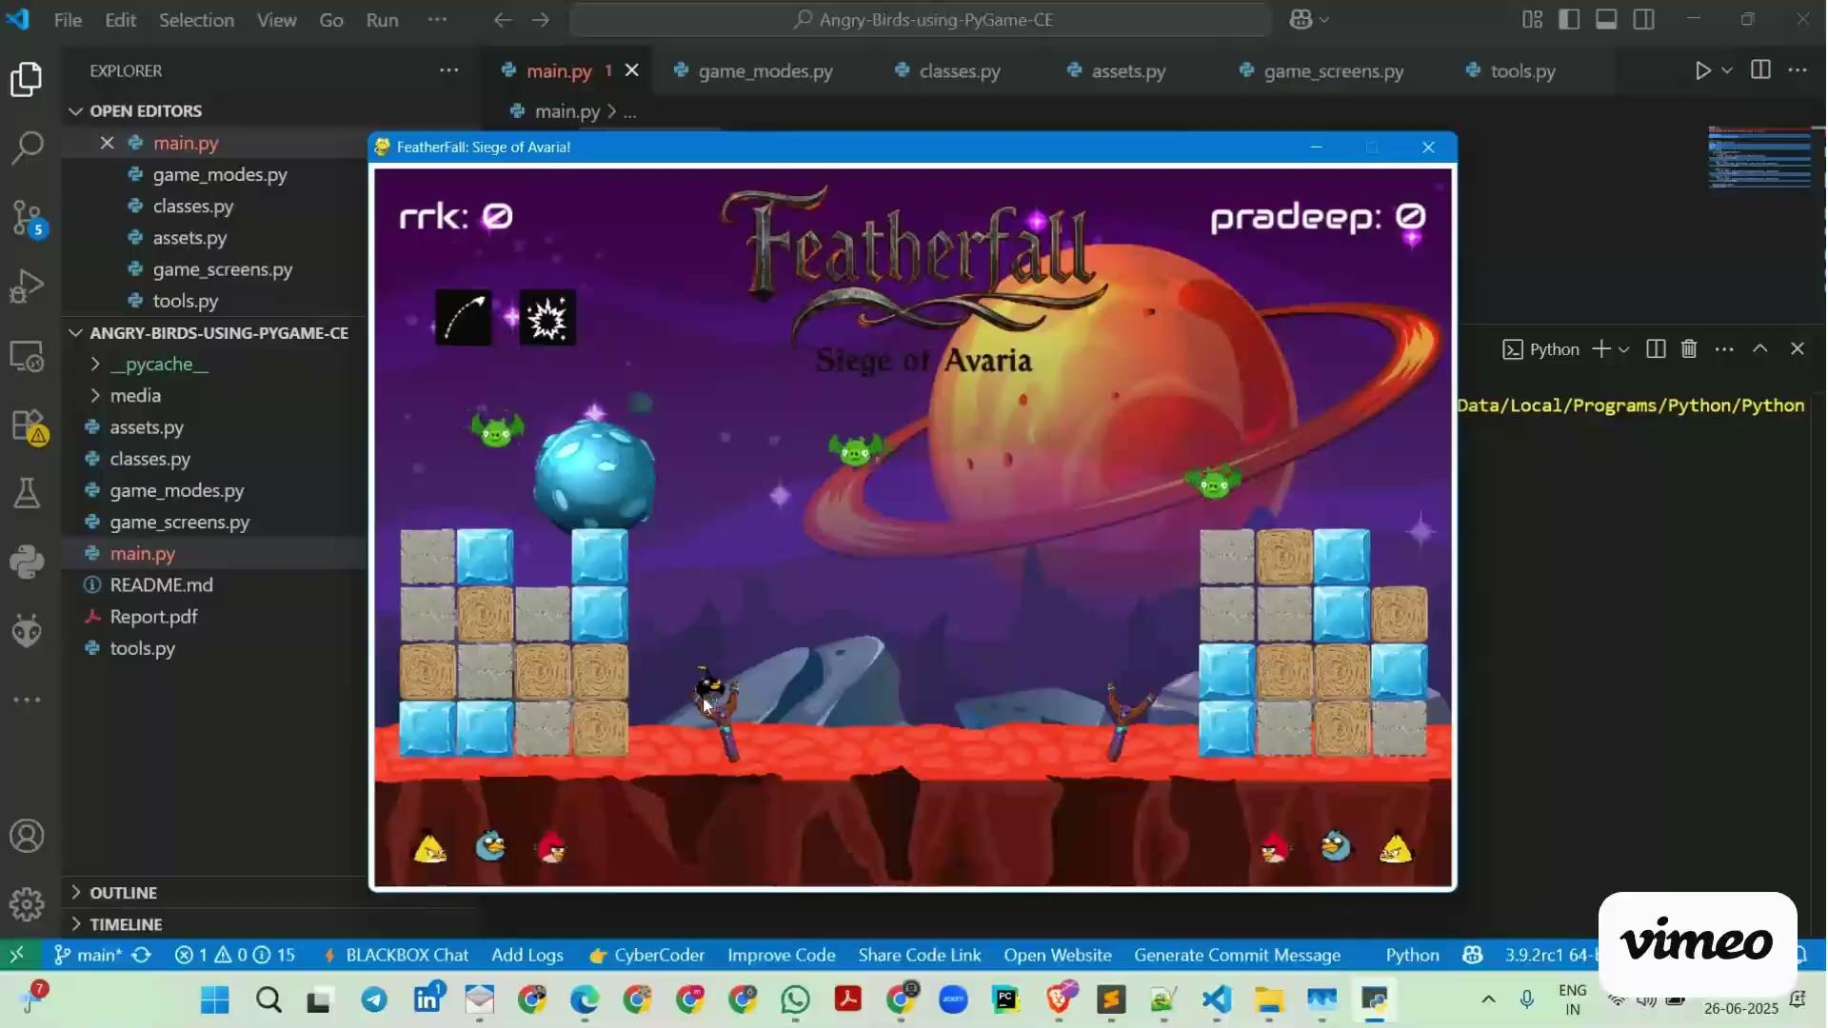
Session 10 VIDEO LINK
Scoring & Game Over Logic

